Slide 1
SECURITY ORIENTATION
IN SUPPORT OF THE NATIONAL INDUSTRIAL SECURITY PROGRAM

Slide 2


Slide 3
Administrative Matters
If you are taking the on-line version of this briefing
(www.allqsecure.com), you will be required to submit
a record of completion.
Once submitted your security representative will receive an email verifying that you have completed your training session. A record of completion will also be maintained in your individual security file.
If you are attending a “live” briefing, please be sure to complete the sign in record.
If you would like a copy of this briefing, please visit www.allqsecure.com and download the latest version! (Hey – its FREE!)

Slide 4
SO…What’s this briefing all about?
PRIMARILY it is about your responsibilities when dealing with our country’s classified information.
Safeguarding classified information is a serious matter … and there will be many references to laws, regulations, directives, contracts, etc. as we proceed.
However, the Industrial Security program involves more than classified information safeguarding …It is also involves:
    Sensitive But Unclassified Information
    Access to sensitive systems and areas (IT systems; facilities; non-public areas)
    Information Management
    Proprietary or other sensitive information (bids, proposals; projects, relationships, trade secrets, etc.)
    Personal conduct
    Responsibility
Its also about the our Security Program

Slide 5

Contents:
Introduction to the Industrial Security Program
Threat Awareness Briefing
Defensive Security Briefing
An overview of the security classification system;
Reporting obligations and requirements.
Job specific security procedures and duties
Company Security and Related Programs

Slide 6
Introduction
As a Government contractor...
  We are bound by Executive Order 12829, National Industrial Security Program, which establishes rules and regulations to properly protect and control all classified material in our possession or under our immediate control.
  We have been granted a Facility Clearance by the Defense Industrial Security Clearance Office – a division of the Defense Security Service (a.k.a. Cognizant Security Agency)
  Employees and to some extent consultants requiring access to classified information in order to perform work on classified contracts are granted “eligibility” by DSS and “access” by the Company (in conjunction with the needs of our government client).
  Background Investigations are conducted by OPM (or their contractors) based upon the employee’s “Need to Know” and the company’s security requirements imposed by contract.

Slide 7
The Company Facility Clearance
A Facility Clearance (FCL) is a determination that a company is eligible for access to classified information or award of a classified contract. This process involves an evaluation of the corporate organization; key leadership; outside corporate relationships; foreign influence, etc.
In other words, an FCL means that a company (or better said, its cleared personnel) may have access to classified information based on a government need and at a government approved location.
An ability to STORE classified information or process classified information requires separate reviews and authorizations.
Companies are required to complete a DOD SECURITY AGREEMENT (DD Form 441) which outlines its security responsibilities.
The Industrial Security Facility Database maintains data on all DoD cleared companies. FSOs and other authorized persons may access the database to verify a company’s FCL. Companies are identified through their “CAGE Code”
2013 Security Orientation

Slide 8
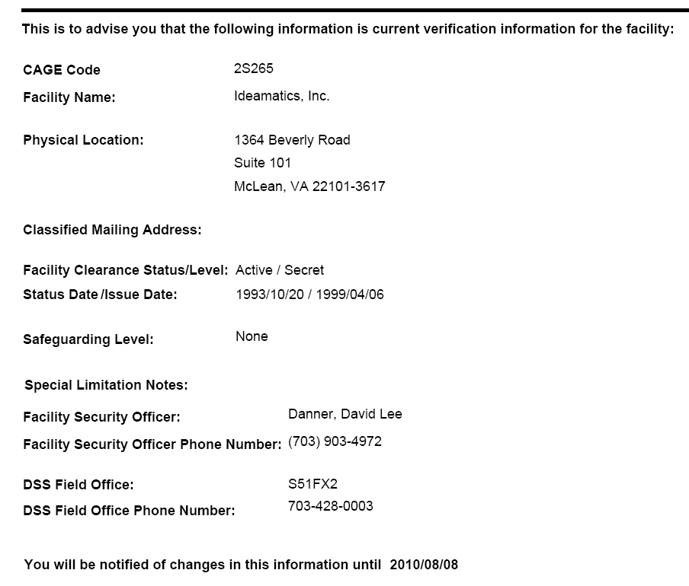
Sample ISFD Verification
1ABC1
BESTCOMPANYEVER
123 4th Street
Suite 789
Alexandria, VA 22315
I. M. SECURE
1-800-SEC-CALL

Slide 9
Personnel Clearances
Once the company receives its FCL, select employees can be granted access to classified information based upon:
ELIGIBILITY | NEED TO KNOW | INDOCTRINATION
Granted by CSA | Established by Contract | Completed by Company
Favorable background inv. | DD 254 requirements | Eligibility & Contract Limits
TS: SSBI | Access to all up to TS; SCI eligible | TS
S: SSBI | Access up to Secret | S
IT Levels: Sensitivity levels | Based on systems and access rqmts | IT Level I, II or III
Suitability: NACI | Non-Sensitive | None – “Favorable”
Other | As per agency | NATO; COMSEC, Etc.
+
+

Slide 10
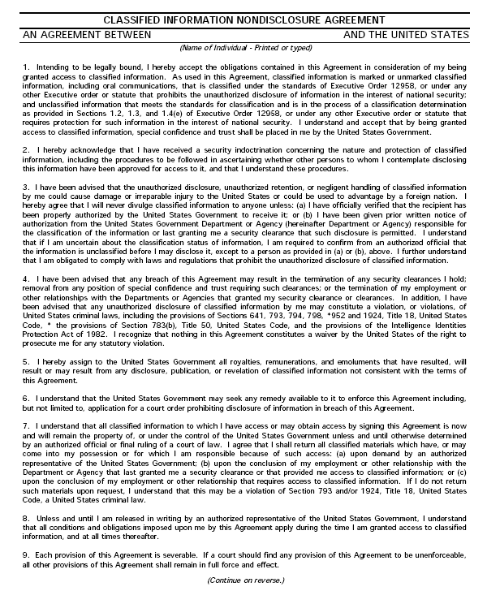



The Non-Disclosure Agreement
A SPECIAL TRUST IS PLACED IN YOU
LIFELONG AGREEMENT
YOU MUST PROTECT FROM UNAUTHORIZED DISCLOSURE
SERIOUS CONSEQUENCES FOR NON-COMPLIANCE

Slide 11

Industrial Security Oversight
Multi-Level Relationships
The End User establishes its security requirements (hopefully together with their IS Group)
The Contracting Officer issues contract to company with DD 254 (as per End User Security Requirements).
The Company FSO and PM evaluate security requirements.
FSO submits required documentation to End User for access authorization.
Company PM evaluates contract performance (including security compliance) on site
DSS Evaluates Company security performance together with the End User security office / PM.
End User Security Office evaluates project security performance – both government employee and contractor

Slide 12


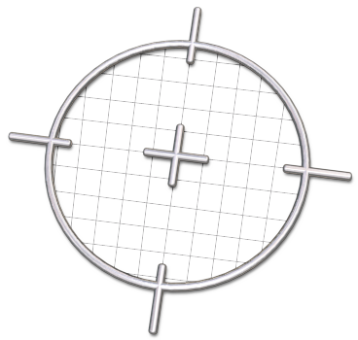

THE THREAT

Slide 13
The Threats
America's role as the dominant political, economic, and military force in the world makes it the Number 1 target for foreign espionage. It’s not just intelligence sources that are targeting us. Other sources of the threat to classified and other protected information include:
  Foreign or multinational corporations.
  Foreign government-sponsored educational and scientific institutions.
  Freelance agents (some of whom are unemployed former intelligence officers).
  Computer hackers.
  Terrorist organizations.
  Revolutionary groups.
  Extremist ethnic or religious organizations.
  Drug syndicates.
  Organized crime.

Slide 14
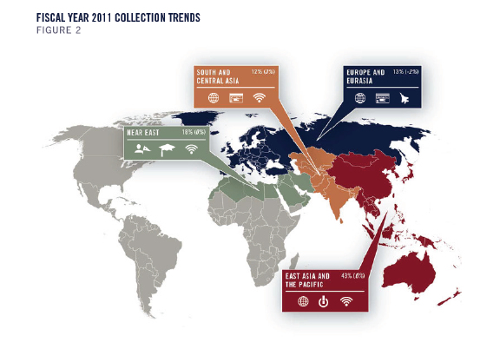
DSS Intel tells us that …
In FY11, suspicious network activity (SNA) was the most prevalent collection MO for
entities originating from East Asia and the Pacific; SNA figured no more prominently than fifth in any other region. Due to the nature of SNA, it remains difficult to
attribute such collection attempts to an entity or even to a region of origin.
The top four most targeted technology categories in FY11—information systems (IS); lasers, optics, and sensors (LO&S); aeronautics systems; and electronics— remained unchanged.

Slide 15
DSS Tells Us that …
Technologies resident in U.S. cleared industry remain highly sought after. Foreign intelligence entities (FIEs) continue to expand their collection networks and activities. These networks are growing like a malignant vine.
This ongoing theft—FIEs’ pilfering of U.S. technologies from cleared industry—could reduce or even end advantages in military capabilities the United States possesses over potential adversaries, thereby adversely affecting U.S. battlefield dominance. It also could strangle U.S economic growth, vitiating the nation’s economic health.
The overall number of reports submitted by cleared industry to the Defense Security Service (DSS) in FY11 increased by nearly 65 percent over FY10, and the number that actually became suspicious contact reports (SCRs) increased by 75 percent, likely due in large part to increased awareness and reporting by industry.

Slide 16
The Threat – Economic & Industrial Espionage
Who Is Doing It?
Due to foreign policy considerations and the need to protect sources, the U.S. Government does not publicly name the countries that are most active in conducting espionage against the United States. However, several European and Asian countries have stated openly that their national intelligence services collect economic intelligence to benefit their industries at the expense of foreign competition. Considerable information on this subject is available in public sources.
What Are They After?
It would be nice to know exactly what classified, proprietary or other sensitive information foreign countries are trying to collect, so that we could then concentrate on protecting that information which is most at risk. Unfortunately, waiting for that kind of specific information before taking appropriate security measures would usually mean locking the barn door after the horses have left.
March 7, 2008: a Reston, VA company, pleads guilty in federal court to illegally exporting "controlled power amplifiers," which have military applications

Slide 17
The Threat (Cont’d)
  The increasing value of technology and trade secrets in the global and domestic marketplaces, and the temporary nature of many high-tech employments, have increased both the opportunities and the incentives for economic espionage.
  The rapid expansion in foreign trade, travel, and personal relationships of all kinds, now makes it easier than ever for insiders to establish contact with potential buyers of classified and other protected information.
  The development of automated networks and the ease with which large quantities of data can be downloaded from those networks and stored and transmitted to others increases exponentially the amount of damage that can be done by a single insider who betrays his or her trust.

Slide 18
The Threat – Economic & Industrial Espionage
Foreign governments’ continued ability to acquire state-of-the-art U.S. technology at little or no expense has undermined U.S. national security by enabling foreign firms to push aside U.S. businesses in the marketplace and by eroding the U.S. military lead.
A clear line must be drawn to protect information that is:
    classified, or
    subject to export controls because it concerns militarily critical technologies, or
    proprietary information that is the intellectual property of a specific firm or individual.
CASE STUDY: “IF AT FIRST YOU DON’T SUCCEED…”
In September 2011, a Massachusetts-based cleared contractor received a request for an export-controlled amplifier from a company based in East Asia and the Pacific. The company did not state the intended end user or end use in the initial contact. Reporting from the same cleared contractor indicated that the model of amplifier requested had been the subject of numerous previous requests, including several from companies located in the U.S. and third countries. Several of these requests listed other East Asia and the Pacific actors as the intended end users. Reporting from other cleared contractors cited several of the entities requesting the equipment as having contacted separate facilities seeking other particular items of sensitive, dual-use technologies. IC reporting identified several of those entities as suspected technology brokers for East Asia and the Pacific actors and enterprises associated with multiple military development projects.

Slide 19

“Globalization and growing economic interdependence,
while creating new levels of wealth and opportunity,
also create a web of interrelated vulnerabilities and spread risks even further…
Department of Defense National Defense Strategy
July, 2008

Slide 20

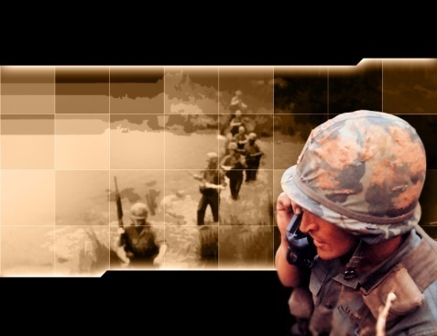
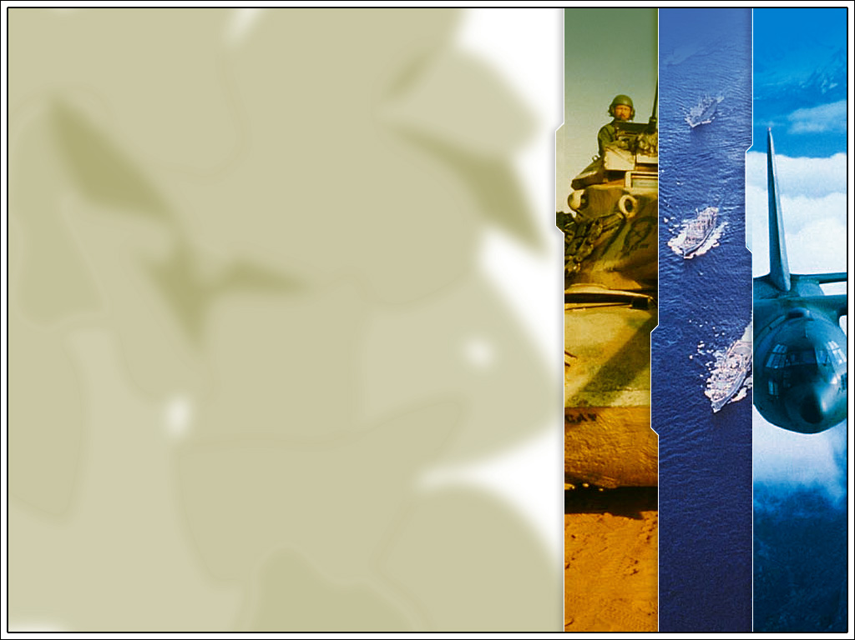
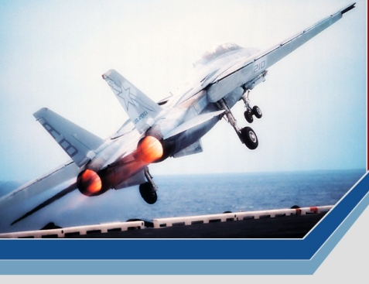
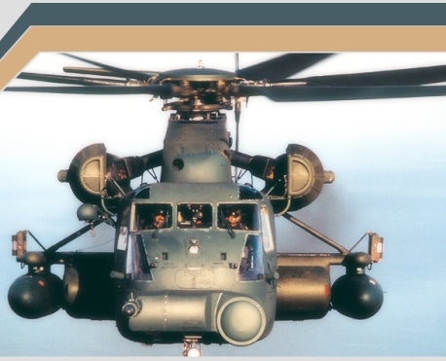
Threat Awareness …
Information concerning troop rotations, locations, equipment; and technology is classified for a reason. Unauthorized release of this information can have a detrimental effect on the Warfighters’ survivability.
Let us not forget who we support.

Slide 21

How do we defend against threats?
"Animal House" Fictional College

Slide 22
First we need to know what we are protecting!
Regarding national security information, it is generally fairly simple to recognize…
TOP SECRET
SECRET
CONFIDENTIAL
FOR OFFICIAL USE ONLY (FOUO)
NATO COSMIC
COMSEC
Sensitive But Unclassified (SBU)
CNWDI
Sensitive Compartmented Information (SCI)
RESTRICTED
TOP SECRET/SI/TK/HS/G/B– ANIMAL HOUSE
SPECIAL ACCESS REQUIRED

Slide 23
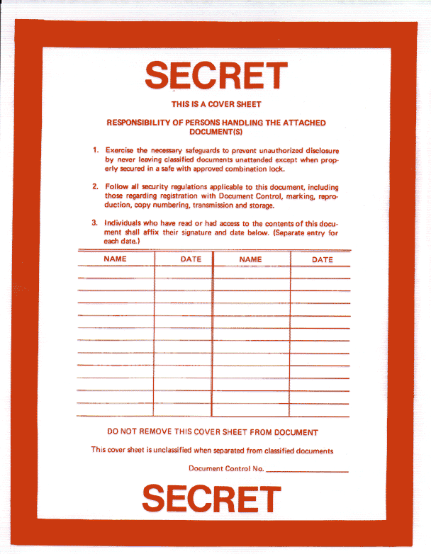
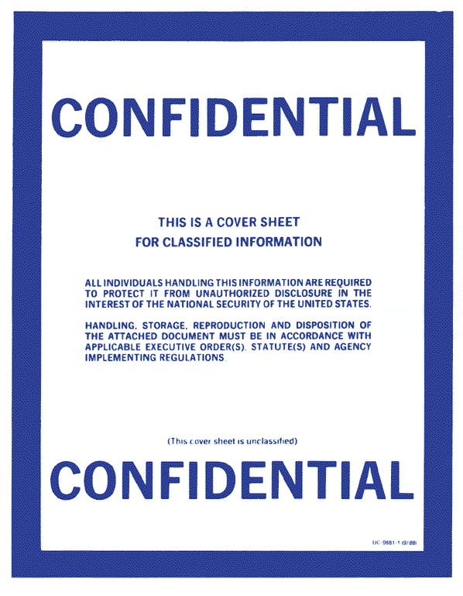
SECRET
National Security Information. Unauthorized Disclosure Subject to Criminal Sanctions.
National Security Information. Unauthorized Disclosure Subject to Criminal Sanctions.
SECRET
CONFIDENTIAL
CLASSIFIED COVER SHEETS

Slide 24
Classified Information:
Must never be left unattended.
Must never be discussed in public places.
Must be discussed on secure telephones or sent via secure faxes.
Must be under the control of an authorized person.
Stored in an approved storage container.
Never be processed on your computer unless approved by the U.S. Government.

Slide 25
Discussing Classified Information
It is your personal responsibility to know that the person you are dealing with is both properly cleared and has a need to know.
You must never reveal or discuss classified information with anyone other than those that are properly cleared and have a need to know.

Slide 26
You must report…
Loss, compromise, (or suspected loss or compromise) of classified or proprietary information,
This includes evidence of tampering with a container
used for storage of classified information.
If you find an unlocked security container which is unguarded or left unlocked after-hours.

Slide 27
You must report…
If a member of your immediate family (or your spouses immediate family) takes up residence outside the United States, or if you acquire relatives (through marriage) who are residents or citizens of a foreign country.
Immediately report any
employment by a foreign
interest.
PERSONNEL HOLDING TS/SCI MAY HAVE ADDITIONAL REPORTING REQUIREMENTS. CHECK WITH YOUR GOVERNMENT CLIENT OR FSO.

Slide 28
Foreign Interest:
A foreign government – or
Any business enterprise organized under the
laws of any country other than the U.S. or its
possessions - or
Any form of business enterprise which is owned
or controlled by a foreign government, firm,
corporation or person - or
Any person who is not a citizen or national of the U.S.

Slide 29
Protecting Yourself in an Uncertain World
When traveling on company business or for personal reasons, plan and prepare.
Develop a personal travel plan and give it to your office and family.
Learn about the culture, customs and laws of countries you visit.
Visit the Department of State Web Site for info on Threat Advisories.
Coordinate with your FSO for overseas Company travel
Don’t forget an Anti-Terrorism / Force Protection Briefing and Travel Briefing
PERSONNEL HOLDING TS/SCI MAY HAVE ADDITIONAL REPORTING REQUIREMENTS. CHECK WITH YOUR GOVERNMENT CLIENT OR FSO.

Slide 30
Security Violations Bring Disciplinary Actions
For Minor Violations Action MAY Include:
Verbal Counseling
Written Counseling
Suspension/Termination
For Major Violations Action MAY Include:
Same as minor violations
Loss of security clearance
Arrest
Imprisonment or fines

Slide 31
Qivliq Security Program
Common Security Services Agreements
One FSO for all – supported by Sector Security Staff
Federal Services Group
Federal Products Group
Others
Services Provided:
  DD 254 reviews (for contract performance); Sub DD 254 issuance
  Personnel Security applications (eQIP)
  JPAS / VAR submissions
  Training, etc.

Slide 32
Report It! (Hotline Numbers)
Federal Bureau of Investigation
The FBI has 56 field offices. The phone number of the nearest office is listed under United States Government in your local phone book.
Defense Department
1-800-424-9098, (703) 693-5080
Defense Security Service (DSS)
(Defense contractors report suspect incidents to local DSS industrial security representative)
Defense Intelligence Agency
(703) 907-1307
National Security Agency
(301) 688-6911
Department of Army
1-800-CALLSPY
Naval Criminal investigative Service
1-800-543-NAVY
Air Force Office of Special Investigations
(202)767-5199
Central Intelligence Agency
Office of the Inspector General
(703) 874-2600
Department of Energy
(202) 586-1247
U.S. Nuclear Regulatory Commission
Office of the Inspector General
1-800-233-3497
US Customs Service
1-800-BE-ALERT
Department of Commerce/Office of Export Enforcement
(202) 482-1208 or 1-800-424-2980 (to report suspicious targeting of US export-controlled commodities)
Department of State
Bureau of Diplomatic Security
(202) 663-0739
When traveling overseas, suspect incidents should be reported to the Regional Security Officer (RSO) or Post Security Officer (PSO) at the nearest U.S. diplomatic facility.

Slide 33
Questions?
Give us a call or submit your question via the briefing RESPONSE FORM.

