Slide 1
AN OVERVIEW OF THE INDUSTRIAL SECURITY PROGRAM

Slide 2
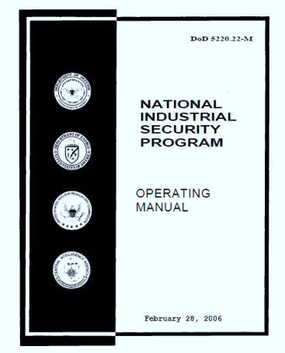
Industrial Security
U.S. industry develops and produces the majority of our nation's defense technology – much of which is classified – and thus plays a significant role in creating and protecting the information that is vital to our nation's security. The National Industrial Security Program (NISP) was established by Executive Order 12829 to ensure that cleared U.S. defense industry safeguards the classified information in their possession while performing work on contracts, programs, bids, or research and development efforts.
The Defense Security Service (DSS) administers the NISP on behalf of the Department of Defense and 24 other federal agencies. There are approximately 13,300 contractor facilities that are cleared for access to classified information.

Slide 3
To have access to U.S. classified information and participate in the NISP, a facility – a designated operating entity in private industry or at a college/university – must have a bona fide procurement requirement. Once this requirement has been established, a facility is eligible for a Facility Security Clearance.
A Facility Security Clearance is an administrative determination that a facility is eligible to access classified information at the same or lower classification category as the clearance being granted. The Facility Security Clearance may be granted at the Top Secret, Secret or Confidential level.
Procurement Requirement
In order to obtain the clearance, the contractor must execute a Defense Security Agreement which is a legally binding document that sets forth the responsibilities of both parties and obligates the contractor to abide by the security requirements of the National Industrial Security Program Operating Manual.

Slide 4
Once a facility is cleared, DSS has oversight authority to evaluate the security operations of the organization. The DSS Industrial Security Representative (ISR) is the principal interface with cleared industry under the NISP. The approximately 280 ISRs, spread across the United States in four geographic regions and 61 field locations, work in a professional partnership with the contractor's facility management staff and facility security officer to ensure the protection of classified information released under contractual obligations or research and development efforts. In addition, the ISR works with government customers on facility clearance issues which may impact on the contractor's ability to perform on the classified contract. In fiscal year 2010, ISRs conducted over 9,400 security inspections and DSS issued 1,279 new facility clearances.
DSS is also responsible for certifying, accrediting and evaluating on a continuous basis the automated information systems used by cleared industrial facilities to process classified information. At the end of FY10, there were approximately 18,438 accredited systems in industry.
THE DEFENSE SECURITY SERVICE

Slide 5
Sponsorship
The company must be sponsored either by a government activity or a cleared US Government contractor.
Requires the approval of the government contracting activity (GCA).
Contractual relationship must exist – Sponsoring cleared contractor issues sub-contract to company for work requiring access to classified at a specified level (Secret or Top Secret)
Sponsoring cleared contractor also issues a DD Form 254 – Department of Defense Contract Security Classification Specification.
The DD 254 is a legally binding document and is incorporated into the contract as part of the terms. conditions and specifications.
THE PROCESS
“The Prep Work”
Sponsor
Establishes Contractual requirement
GCA Approval
Verifies the need
DD 254 and Sub-Contract
Provides security specifications and requirements

Slide 6
Day 1
DISCO receives Sponsorship Packet
Conducts preliminary evaluation and assigned to DSS F.O.
Day 30
Responsible DSS Office meets with company.
Conducts review of corporate documents; KMP List, etc.
Day 31 +
Corporate structure and FOCI evaluated
Key management Personnel processed for personnel clearance
THE PROCESS
“Time moves on”
Corporate Information and Key Management Personnel
Articles of Incorporation, Stock Records, Minutes of Board Meetings, and Corporate by-laws.
Federal Tax ID Number.
Any 10K Reports filed with the Securities Exchange Commission.
Key Management Personnel List. The senior management official, the prospective Facility Security Officer (FSO), all executive committee members, and all board members including the Chairman should be listed.
Brief summary of your company's primary business or services provided.
email, Fax, and complete address information for the last ten years — include the last four number extension on your zip code.
Proof of US Citizenship for prospective Facility Security Officer (FSO)

Slide 7
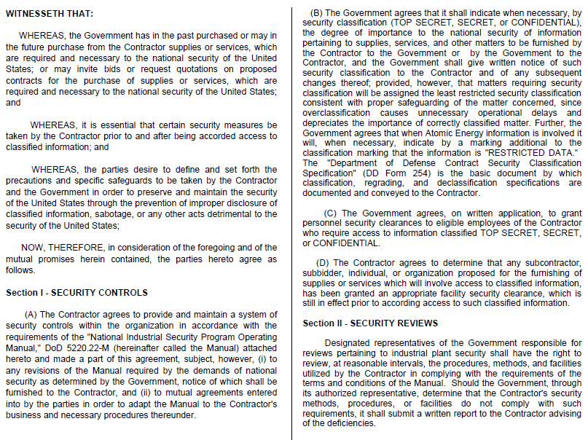
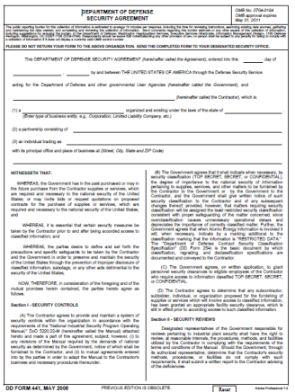
DD Form 441
Signed by company senior representative
Legally binding

Slide 8
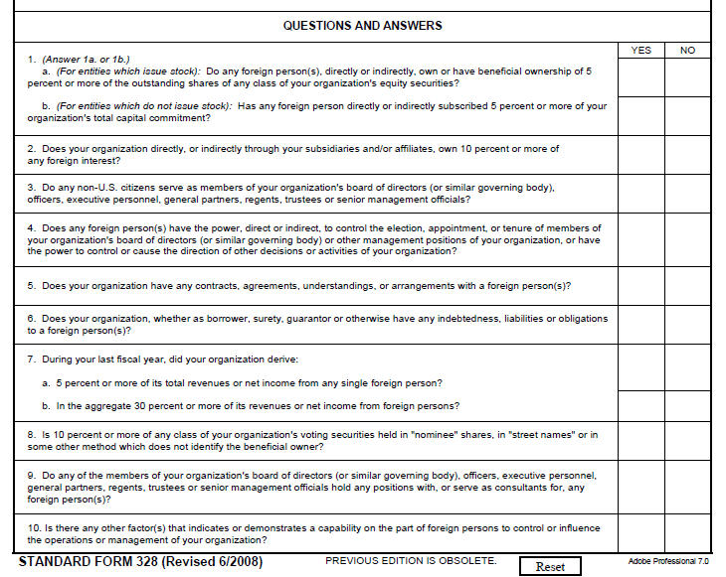
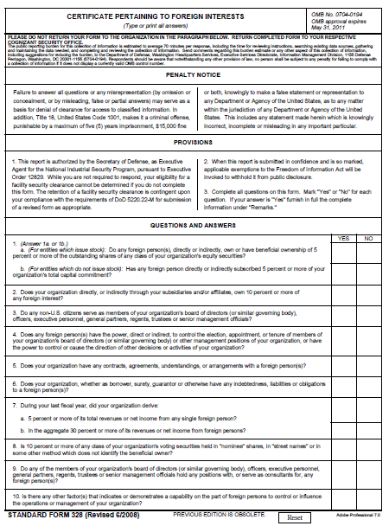
SF 328 – Certificate pertaining to Foreign Ownership, Control or Influence (FOCI)

Slide 9
The evaluation and approval process follows two distinct tracks – each dependent upon the other.
OK – All the forms have been submitted – when does the company get cleared?
ANSWER:
“It Depends”
If All KMP are already cleared – 30 to 60 days for Final FCL
If All KMP are not already cleared – 30 to 60 days for Interim FCL
If all KMP are not already cleared – 30 to ?? Days for Final FCL
CORPORATE
(FCL)
VERIFICATION OF LEGAL STATUS
VERIFICATION OF SUPPLIED DOCUMENTATION
PERSONNEL
(PCL)
KEY MANAGEMENT PERSONNEL PROCESSED FOR CLEARANCES
FSO, PRESIDENT, BOARD / COUNCIL MEMBERS
DSS WILL DETERMINE WHO MUST BE CLEARED
FOCI EVALUATION
FINAL FCL WILL NOT BE GRANTED UNTIL ALL KMP HAVE A FAVORABLY ADJUDICATED FINAL INVESTIGATION.
WHEN KMP ARE GRANTED INTERIM CLEARANCE, COMPANY WILL ALSO BE GRANTED INTERIM FCL.

Slide 10
What types of things can prevent someone from receiving a security clearance?
With rare exceptions the following will result in a clearance denial:
criminal conviction resulting in incarceration for a period of one year or more
current unlawful use of or addiction to a controlled substance
determined to be mentally incompetent by a mental heath professional approved by DoD
discharge or dismissal from the Armed Forces under dishonorable conditions
unwillingness to surrender a foreign passport
Otherwise, the most common reasons for clearance denial are:
serious repeated financial problems,
intentional false statements in connection with a clearance investigation,
recent illegal drug involvement,
repeated alcohol abuse, and
a pattern of criminal conduct or rule violation.
KMP PCL PROCESSING – BACKGROUND INVESTIGATION ISSUES

Slide 11
QUESTIONS?

